Slide 1

Vel Tech Rangarajan Dr. Sagunthala R&D Institute of Science and Technology
School of Computing
Department of Computer Science and Engineering
10211CS224 / FULL STACK APPLICATION DEVELOPMENT (JAVA)
END SEMISTER PROJECT REVIEW
Date: 06-05-2026
React Js Based Web Application For Ticket Booking Of An Internal Department Event
SDG: SDG 9-Industry, Innovation and Infrastructure
Courses Handling Faculty:
Dr.S.Hemamalini-M.E.,PH.D,
Assistant Professor
Presented By:
T.INDRANI –VTU24820– 23UECS0902

Slide 2
INTRODUCTION
Campus Ticket Booking System for managing university events
Online platform for event discovery and ticket reservations
Enables students and staff to book tickets anywhere, anytime
Simplifies event registration for organizers and attendees
Eliminates paper-based ticketing and manual queues
Supports multiple event types like workshops, seminars, and cultural programs
Provides a central portal for campus event information
Improves communication between organizers and participants
Enhances user experience with convenient booking workflows ,Reduces administrative workload and improves process reliability
1
2
3
4
5
6
7
8
9

Slide 3
PROBLEM STATEMENT
1
Campus event ticketing is often manual and time-consuming
Paper forms, emails, and in-person registration cause delays
Booking data is hard to track and easily lost
Overbooking and inaccurate capacity control are common
Attendees lack real-time booking status and confirmations
Organizers cannot easily monitor ticket sales, Manual reconciliation of bookings is error-prone
Resource allocation and event planning suffer from poor data
Students face inconvenience when registering for events
The current system is inefficient and lacks automation
2
3
4
5
6
7
8
9

Slide 4
OBJECTIVE(S)
1
Provide a user-friendly online ticket booking experience
Automate event registration and ticket issuance, Maintain accurate records of users, events, and bookings
Enable real-time status of ticket availability, Reduce administrative effort and paper usage
Ensure secure user authentication and data safety
Track event attendance and booking history
Improve organizer visibility into event metrics
Support faster response to booking changes
Build a scalable system for future campus events
2
3
4
5
6
7
8
9

Slide 5
PROPOSED SYSTEM
1
Web-based application with separate frontend and backend
Responsive UI for browsing events and booking tickets
Backend REST API for user, event, and ticket operations
Database storage for users, events, tickets, and bookings
Reporting tools for sales, attendance, and analytics
Authentication and session handling for secure access
Centralized management of event inventory,Automated confirmation and ticket status updates
Dashboard for organizers to manage events and capacity,Scalable architecture suitable for campus deployment
2
3
4
5
6
7
8
9

Slide 6
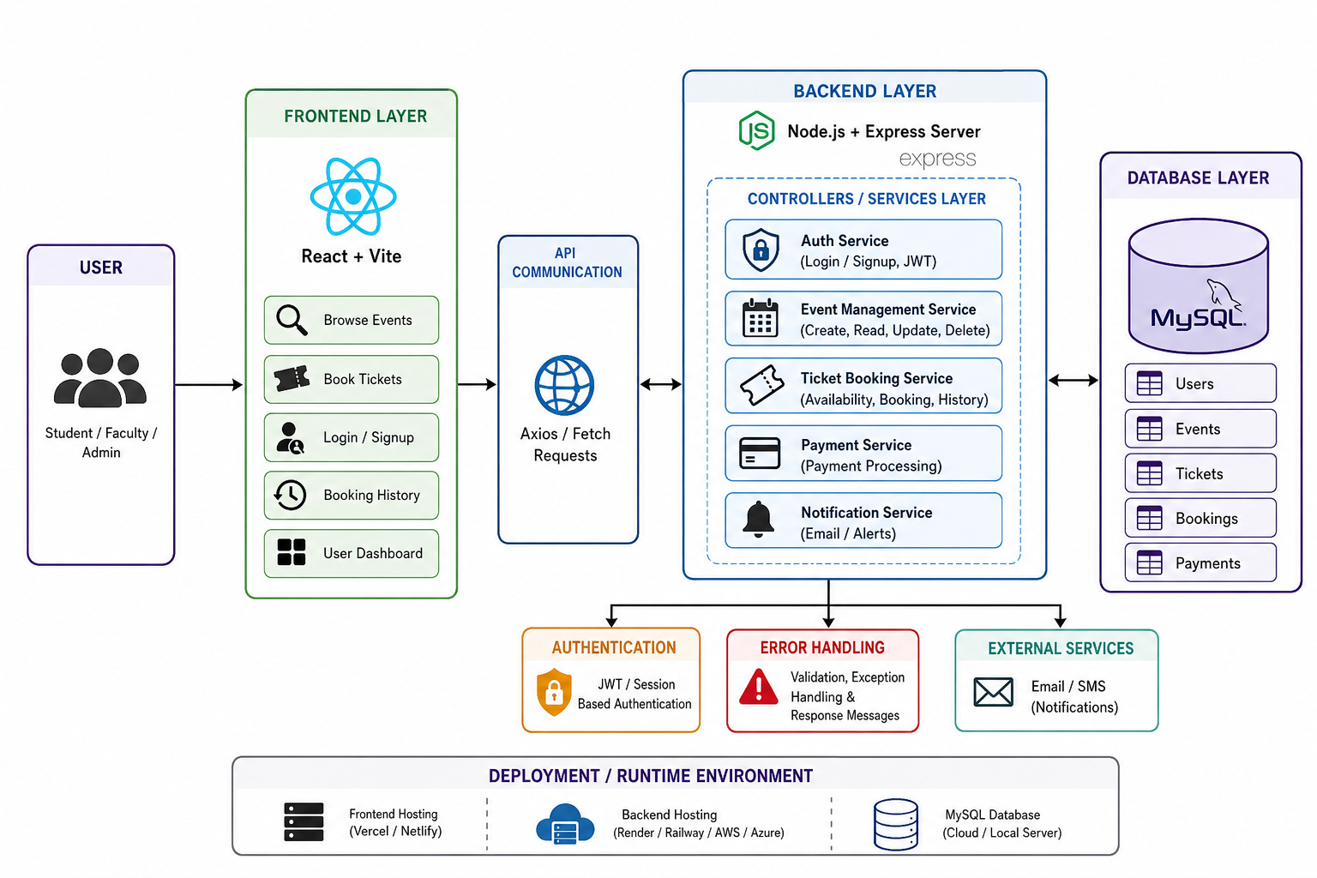
PROPOSED SYSTEM ARCHITECTURE
1
2
3
4
5
6
7
8
9

Slide 7
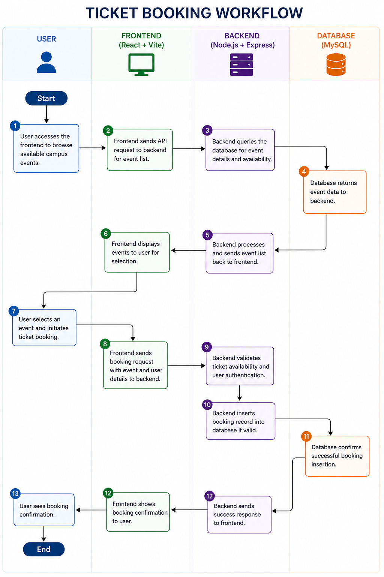
WORKFLOW
1
2
3
4
5
6
7
8
9

Slide 8
TECHNOLOGIES USED
Backend: Node.js and Express.js
Frontend: React.js with Vite
Database: MySQL or another relational database
API communication: Axios or Fetch
Authentication: JWT or session-based login
Styling: CSS, responsive design principles
Development tools: npm, modern JavaScript, Git
Server runtime: Node, Express middleware
Data modeling: relational schema for integrity
Deployment: local server or cloud hosting options
1
2
3
4
5
6
7
8
9

Slide 9
MODULE DESCRIPTION
1
Module 1: User Management
The User Management module handles registration, login, and profile management for campus users.
It securely stores user credentials and maintains booking history for each account. This module also supports
role-based access so students and organizers can use the right features.
Module 2: Core Processing
The Core Processing module manages event listing, ticket booking, and availability checks in real time.
It validates requests, prevents overbooking, and confirms reservations immediately. This module is the engine
that keeps booking workflows smooth and reliable.
Module 3: Database Management
The Database Management module stores all data for users, events, tickets, and bookings in a consistent schema.
It ensures relational integrity and fast retrieval for every system operation. This module also supports ongoing maintenance, backup, and reliable data persistence.
Module 4: Reporting & Analytics
The Reporting & Analytics module generates ticket sales summaries, attendance statistics, and event trends.
It helps organizers review performance, identify popular events, and make better planning decisions. This module converts system data into actionable insights for campus administration.
2
3
4
5
6
7
8
9

Slide 10
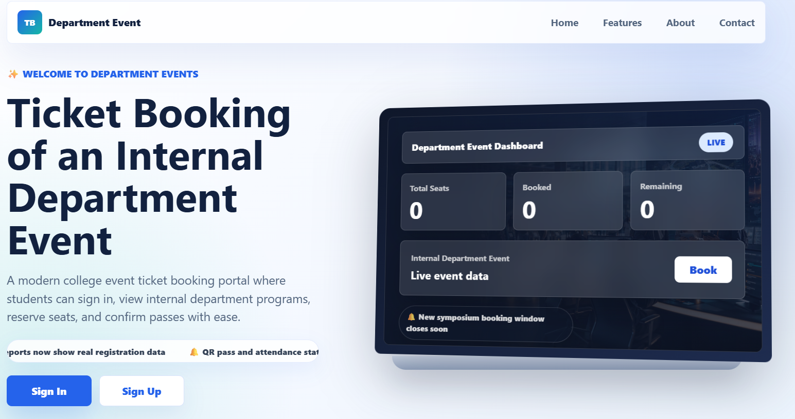
IMPLEMENTATION SCREENSHOTS
Home page :The home page is a user-friendly dashboard for browsing campus events, checking ticket
availability, and starting the booking process.
1
2
3
4
5
6
7
8
9

Slide 11
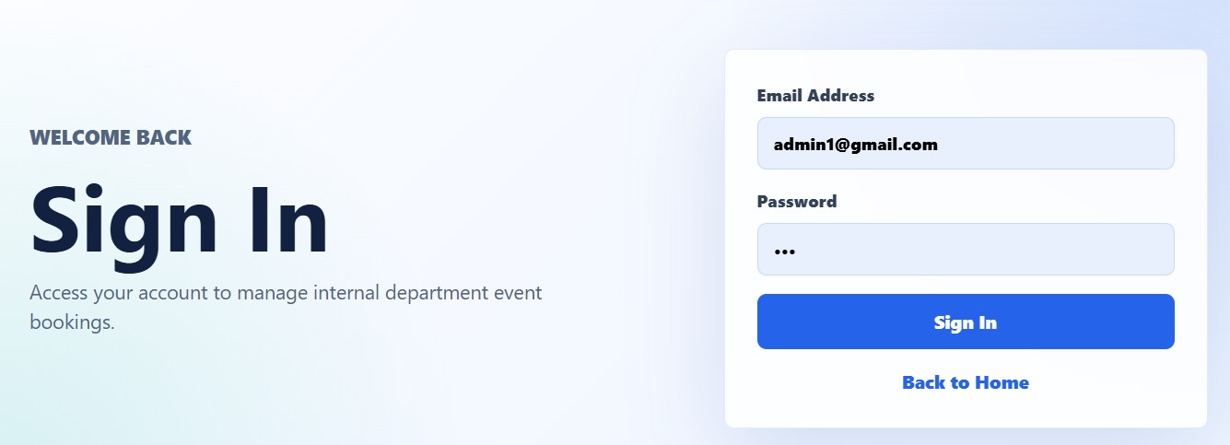
IMPLEMENTATION SCREENSHOTS
1
Login page: The sign/signup page welcomes users with a secure login form, allowing easy access to campus events and ticket bookings. New users can register quickly to create accounts, view booking history, and manage reservations with protected credentials.
2
3
4
5
6
7
8(A)
9

Slide 12
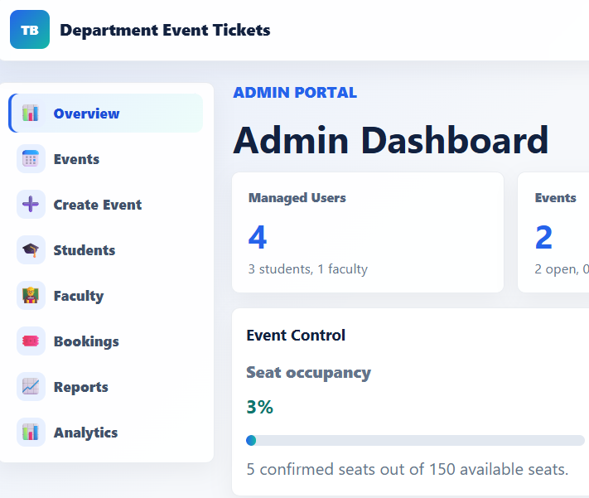
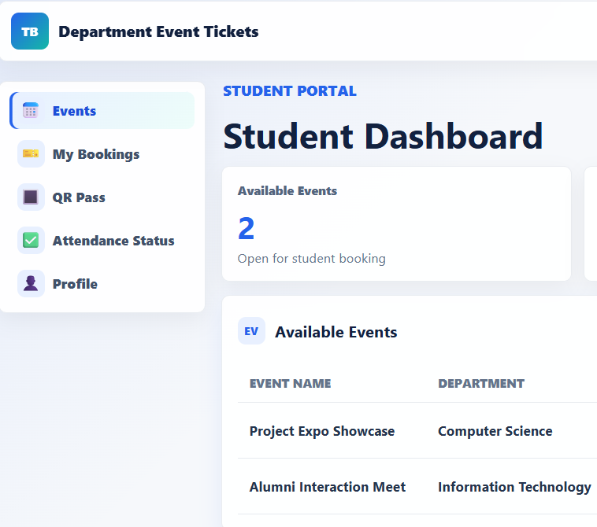
IMPLEMENTATION SCREENSHOTS
1
Admin login page
User login page
2
3
4
5
6
7
8(B)
9

Slide 13
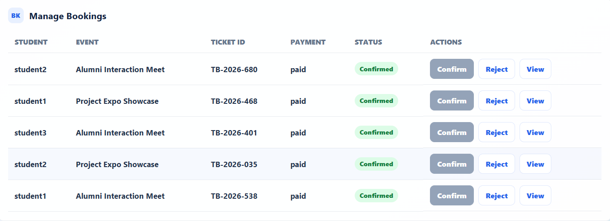
IMPLEMENTATION SCREENSHOTS
1
Main module :This image shows the Manage Bookings module of the ticket booking system. It displays student booking details such as event name, ticket ID, payment status, and booking confirmation status. The admin or faculty can also confirm, reject, or view booking details through the action controls.
2
3
4
5
6
7
8(B)
9

Slide 14
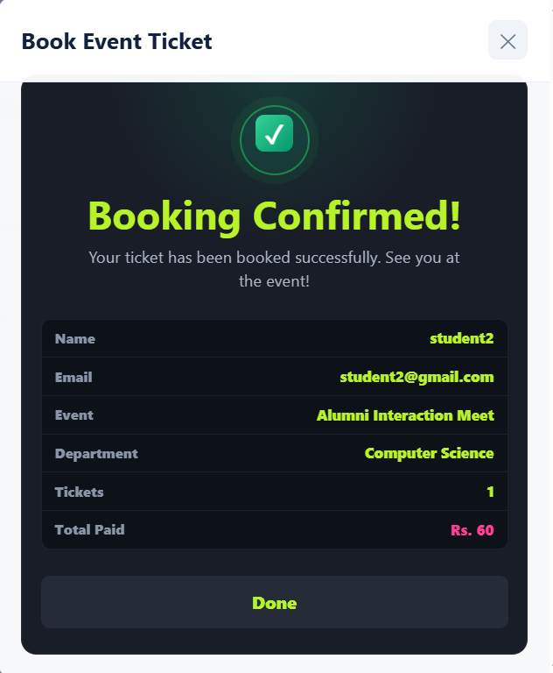
IMPLEMENTATION SCREENSHOTS
1
Output page : The booking confirmation page displays a success message with ticket details, including event name, date, and seat number. Users receive an email receipt and can view their booking history for easy reference and management.
2
3
4
5
6
7
8(C)
9

Slide 15
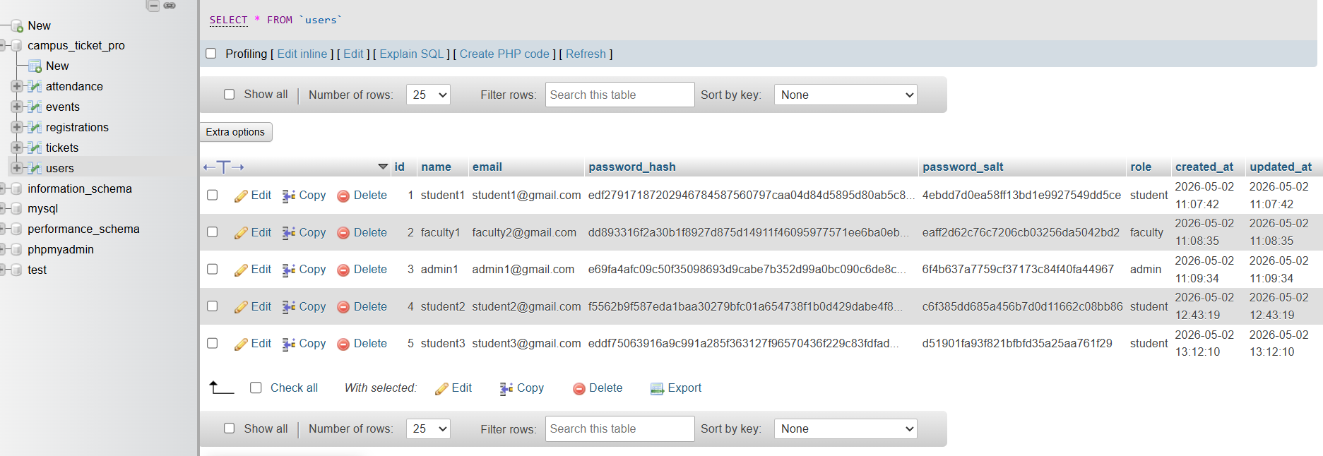
IMPLEMENTATION SCREENSHOTS
1
Data Base:The project uses a MySQL database to store and manage user details, event information, ticket bookings, and payment records. phpMyAdmin is used for database administration, allowing easy data storage, retrieval, and management for the ticket booking system.
2
3
4
5
6
7
8(C)
9

Slide 16
ADVANTAGES & LIMITATIONS
1
Advantages :
Streamlines event registration with online booking, reducing manual effort.
Provides real-time ticket availability, preventing overbooking.
Enhances user experience with a responsive, easy-to-navigate interface.
Maintains secure user data and authentication for privacy.
Offers booking history and confirmations for better user tracking.
Enables organizers to monitor sales and attendance instantly.
Limitations :
Requires internet access for booking, limiting offline users.
Dependent on database reliability for data integrity.
Potential security risks if authentication is compromised.
May face scalability issues with very large user bases.
Limited to campus events, not suitable for external bookings.
Initial setup and training needed for organizers.
Frontend performance could lag with high concurrent users.
2
3
4
5
6
7
8
9

Slide 17
Thank you

